Slide 1

Wireframes Full Flow
08.08.2013

Slide 2
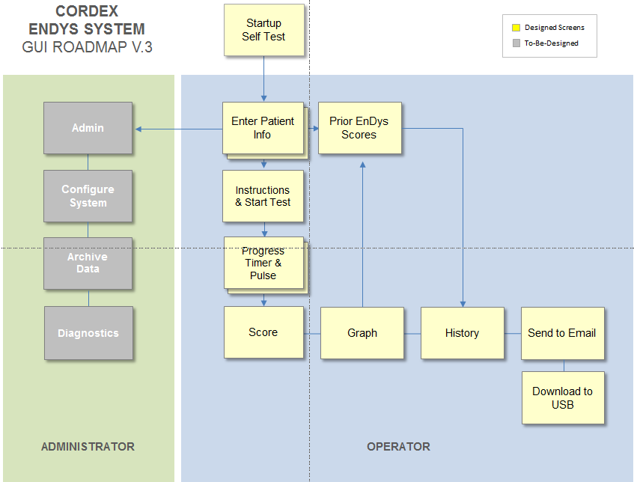
Wireframes Full Flow
GUI Roadmap
Password gatekeeper
History
Notes:
Indicate password protection by color coding (all fields that require password protection are red prior to log in. They turn green after login. Add logout button for all screens)
Required for All Admin Boxes currently with green backdrop
Required for ‘Prior EnDys Scores’
Required for ‘History’ (Question: What is the difference between ‘Prior EnDys Scores’ and ‘History”?)
Required for ‘Download to USB’ ?
Remove Send to Email in Version #1 (Swaps position with ‘Download to USB’ make note that email option will not be in version #1)
How do we get from end of patent #1 test back to ‘Enter Patient Info’ for patient #2 ?
‘Diagnostics’ : 1) Look at results of previous ‘self test’ 2) % full/capacity on disk drive
‘Archive Data’ – Should be able to edit records
‘Configure System’ – 1) Modify hyperemia/hold time 2) Modify maximum pressure setting

Slide 3

Wireframes Full Flow
Self Test
Running Self Test…
Innovating the Traditional…One Heartbeat at a Time

Slide 4
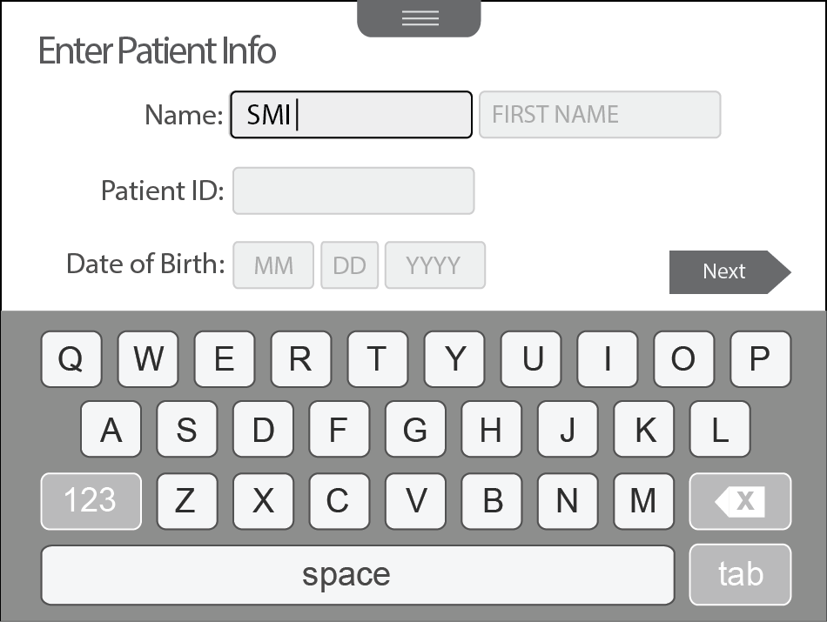
Wireframes Full Flow
New Test – Enter Patient Info (with character keyboard)
Notes:
Keyboard keys are now all-caps.
Prior Scores
Notes:
‘Prior Scores’ Button Added
Do we need “Tab” key?

Slide 5
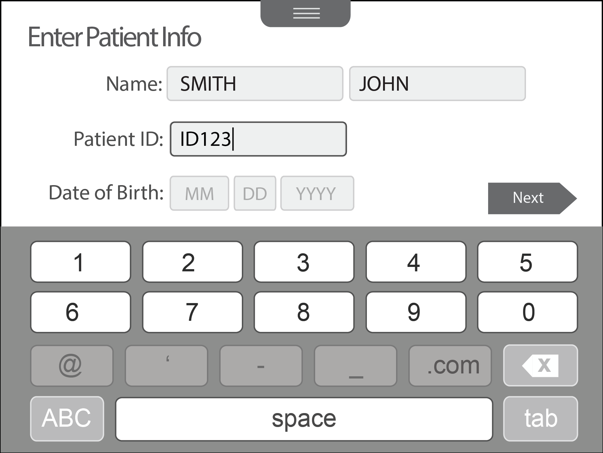
Wireframes Full Flow
New Test – Enter Patient Info (with numeric keyboard)
Notes:
The month keyboard has been removed. User s will use the numeric keyboard to enter the date of birth.
Keys that are not applicable for this field are disabled. For example, @, ‘, -, _, and .com are disabled when in the Patient ID field.
Prior Scores
Notes:
Number keyboard should be activated in all date fields automatically.

Slide 6
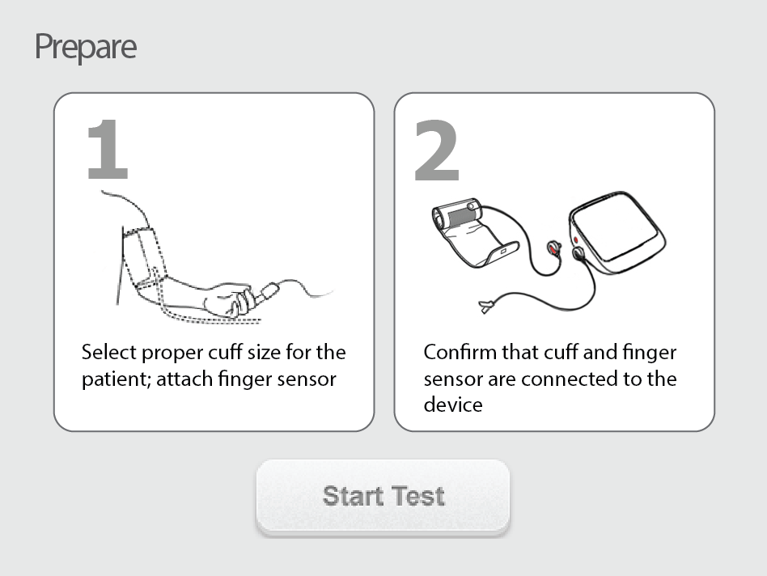
Wireframes Full Flow
Operator Instructions
Notes:
Three steps:
Select proper cuff size
Connect cuff and finger sensor to the device
Attach finger sensor and place cuff

Slide 7
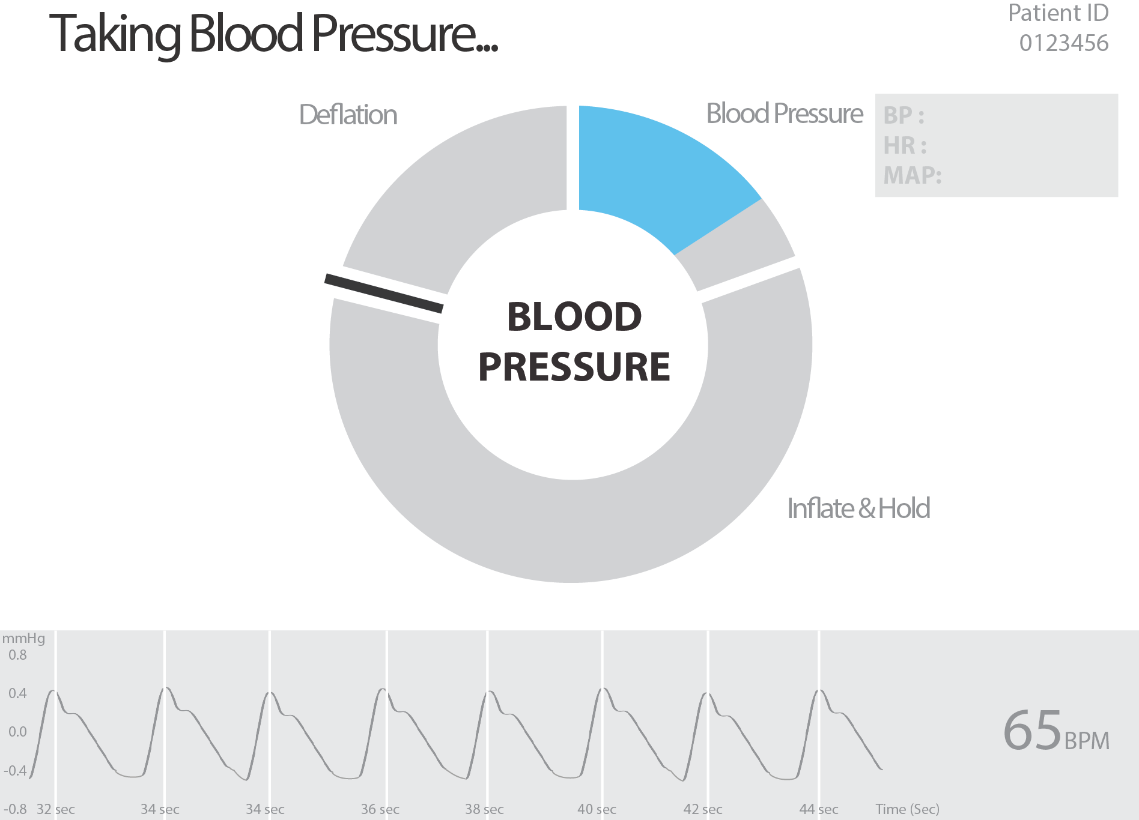
Wireframes Full Flow
Taking Blood Pressure
Halt
Notes:
“Halt” button used to stop test takes them to “confirm” screen to stop test or “resume” to continue test.
Add words ‘remain still’ anytime there is a deflation. (Note: This should occur during the normal and hyperemia tests.)

Slide 8
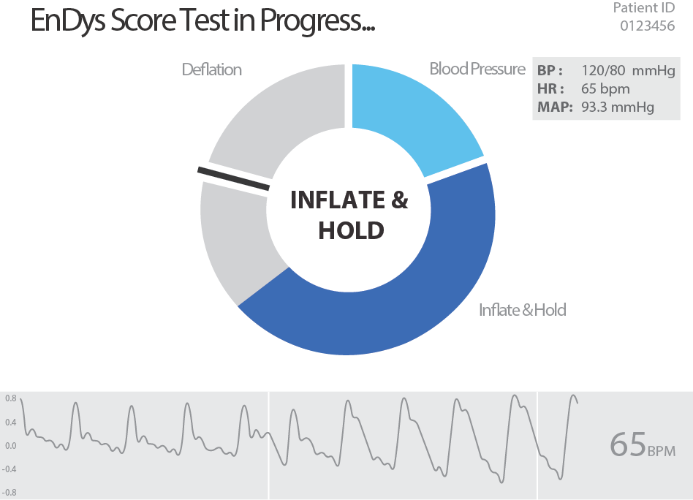
Wireframes Full Flow
EnDys Score Test in Progress
<heart health facts>

Slide 9
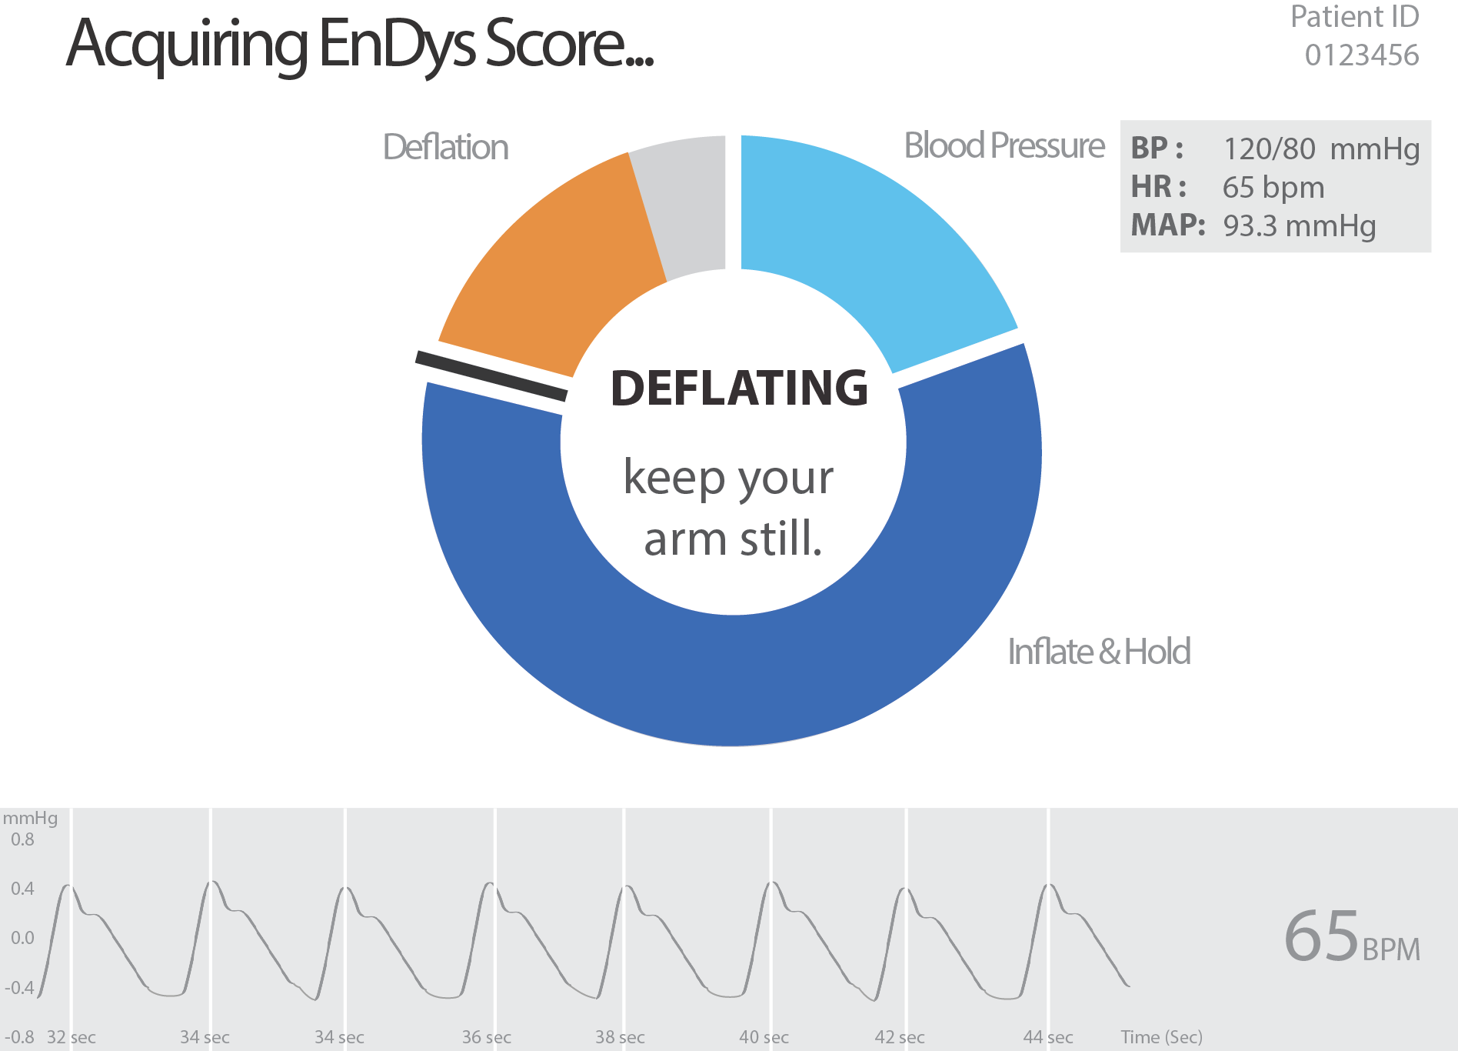
Wireframes Full Flow
Acquiring EnDys Score
Notes:
The new design for “Keep your arm still” with the red bar around a portion of the timer will be shown in the visual concepts.

Slide 10
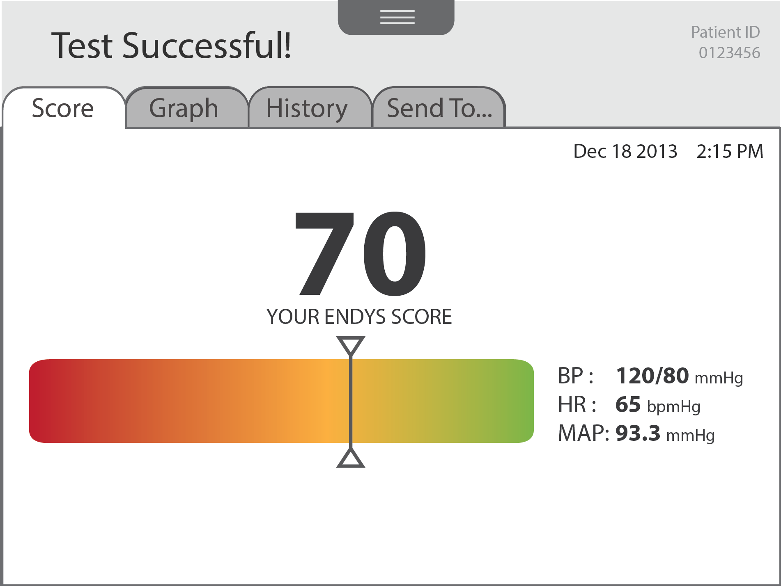
Wireframes Full Flow
Score
Done
Notes:
‘History’ and ‘Send To..’ Tabs will be password protected and color coded.
Red – Not logged in
Green – Logged in
Show ‘Test Failure’ Screen. If ‘Test Failure’ screen is active, user should be returned to prefilled ‘Enter Patient Info.’ screen.

Slide 11
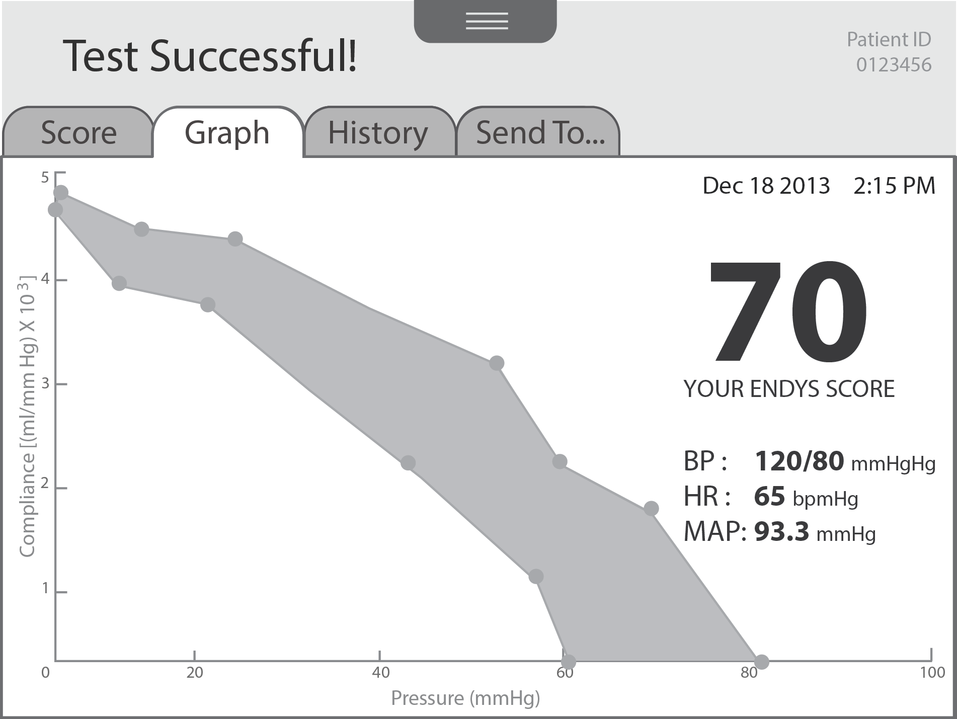
Wireframes Full Flow
Graph
Done

Slide 12
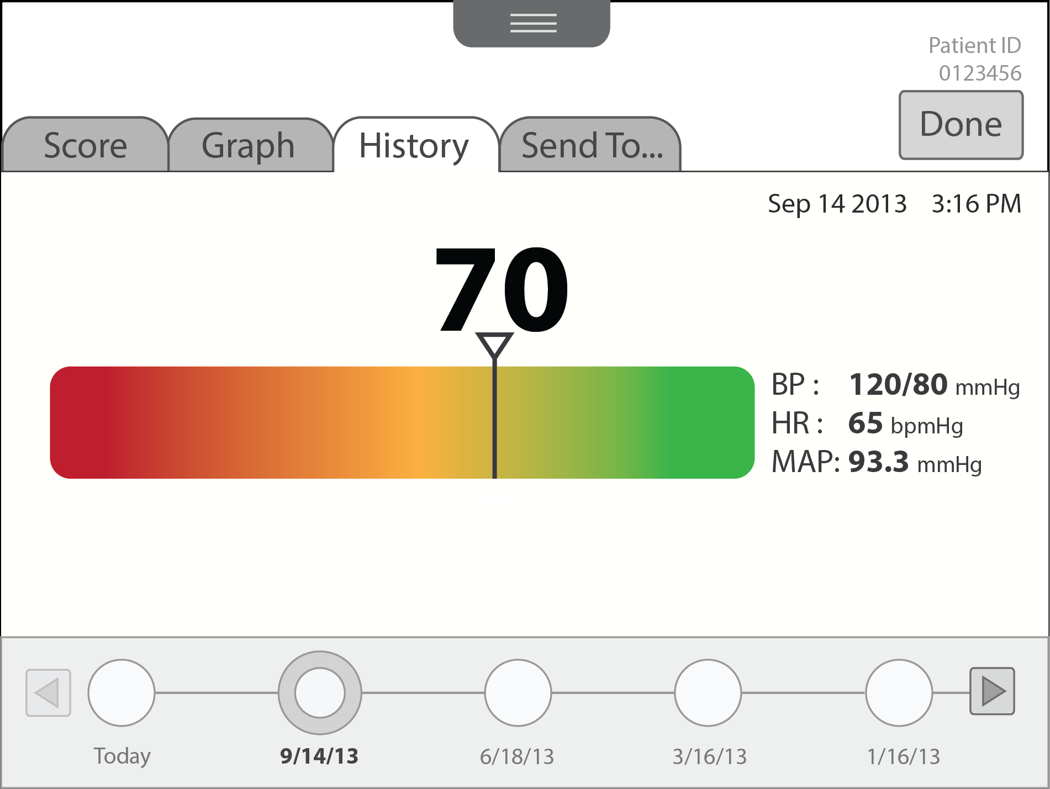
Wireframes Full Flow
History
Notes:
The History tab will display the previous test for this patient. The score, BP, HR, MAP, and the time of the test will be displayed in the history.
Users can select a different date by using the timeline at the bottom of the screen. 5 tests at a time will be listed in the timeline. The user can press the left and right arrows to go to the previous 5 tests or the next 5 tests.
Notes:
- Time should read left to right on the history along the bottom. ‘Today’ should be furthest to the right.

Slide 13
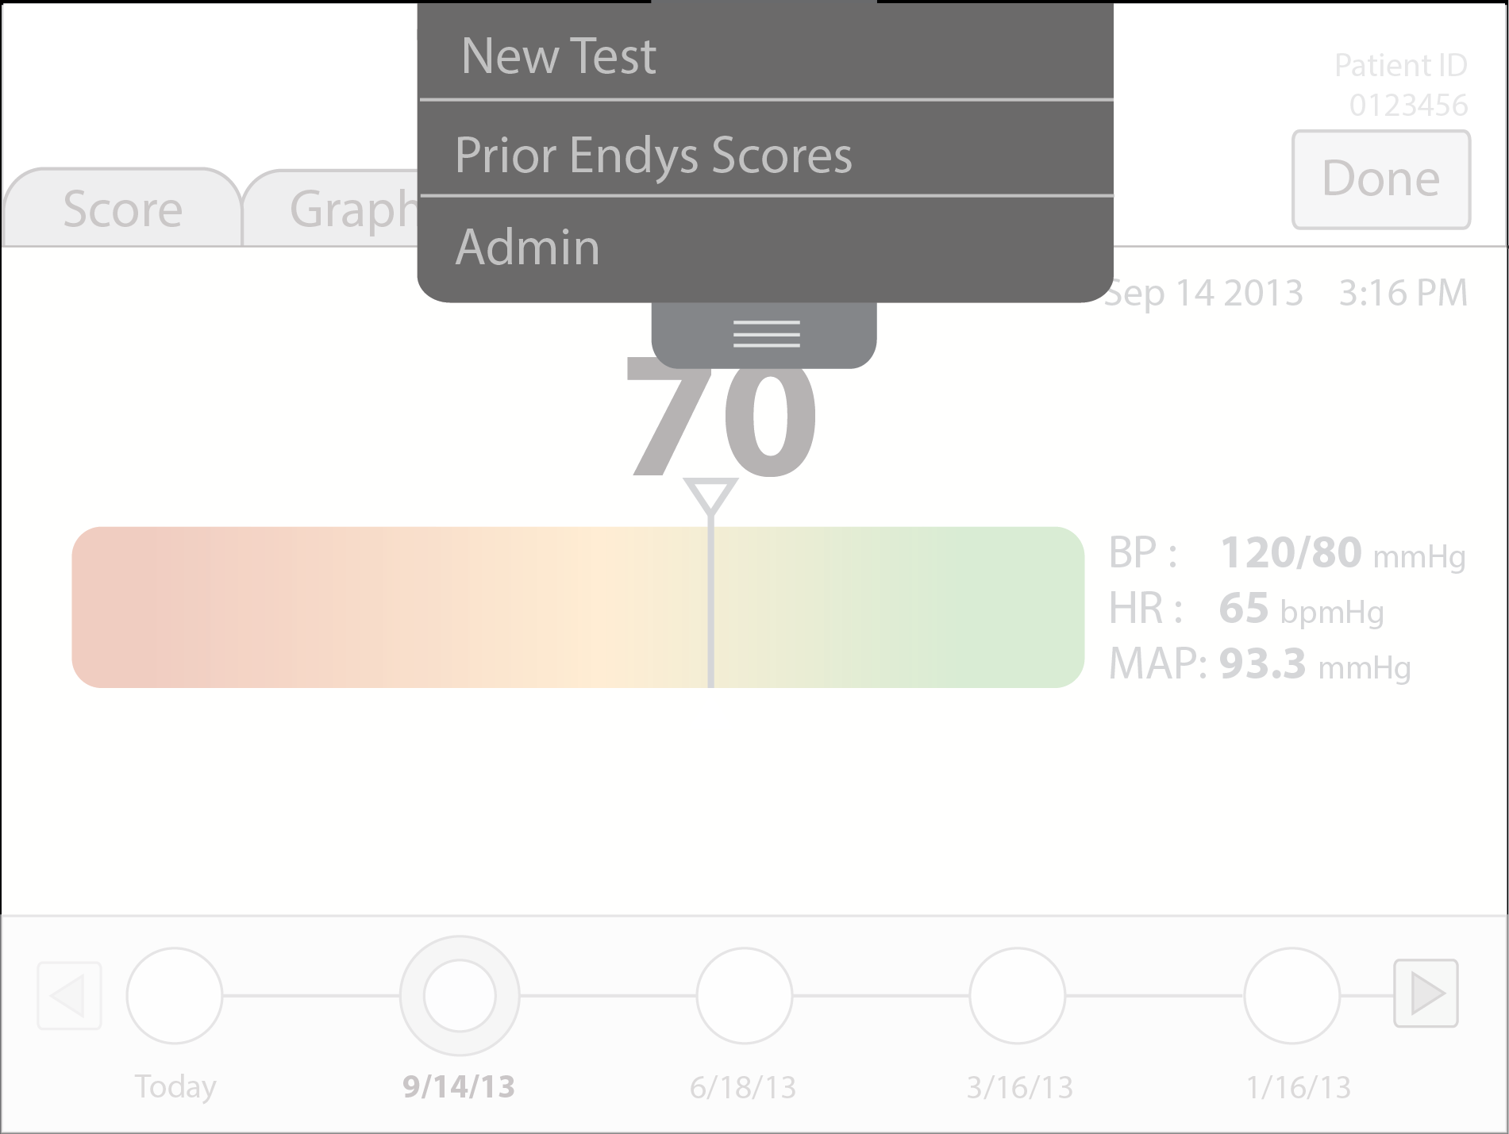
Wireframes Full Flow
Pull-down menu
Notes:
If the user tries to exit out of the test results and go to the menu before they send the score, they should receive the prompt that is on the next slide.

Slide 14
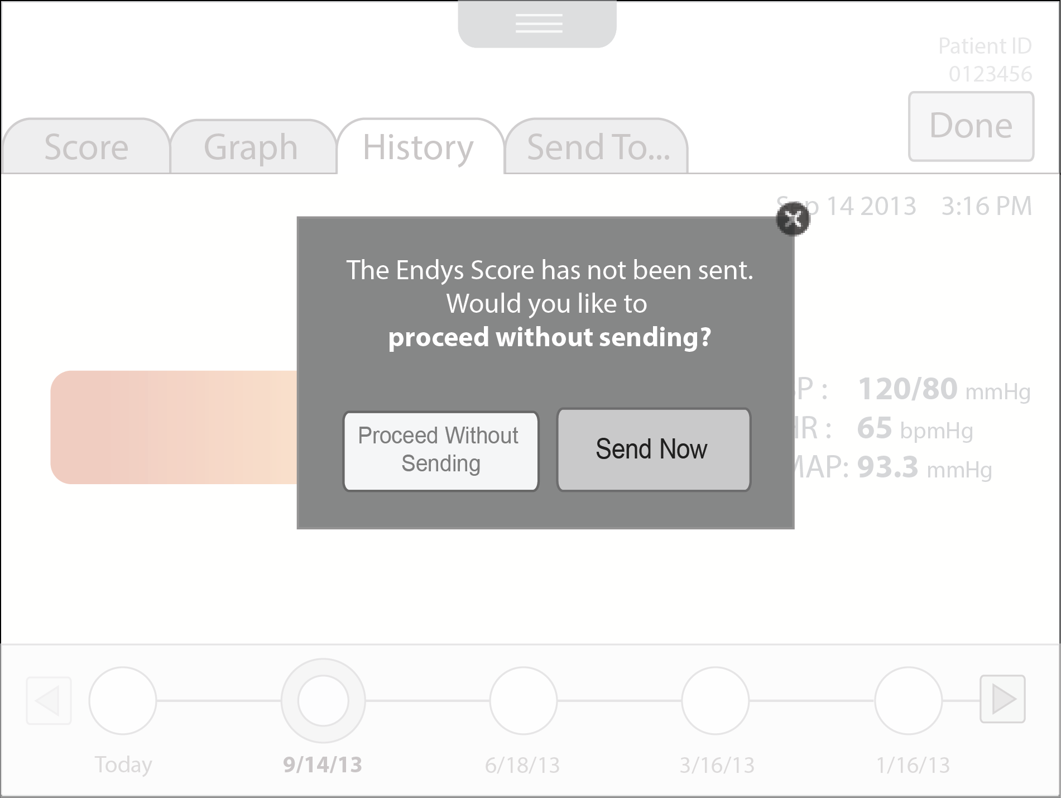
Wireframes Full Flow
Exit Out Prompt
Notes:
If the user selects an item from the pulldown menu and tries to exit the test before they send the score, they will be reminded to send the score prior to exiting.

Slide 15
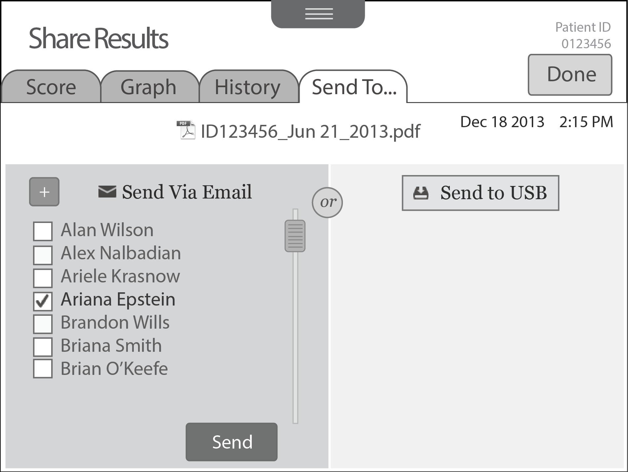
Wireframes Full Flow
Send to Email
Notes:
If the user clicks the “Send Now” button in the prompt, they will be brought to the Send To tab.

Slide 16
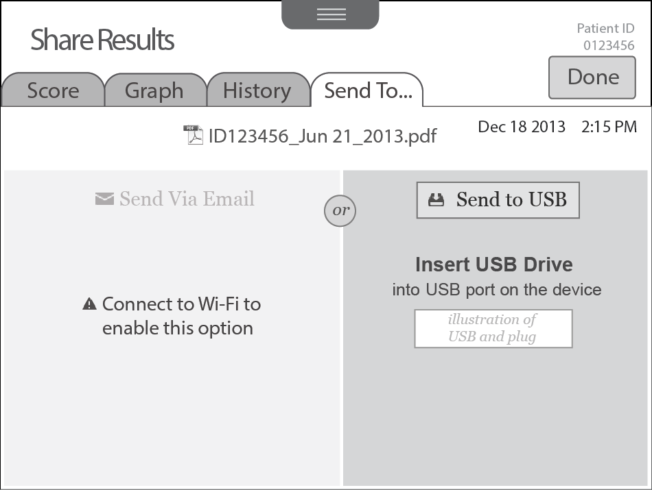
Wireframes Full Flow
Send to USB - Step 1
Notes:
This scenario shows what the screen would look like if the wifi connection has been disabled. There would be no email addresses listed on the left side of the screen.
If the user chooses the Send to USB option they will be prompted to insert a USB drive.

Slide 17
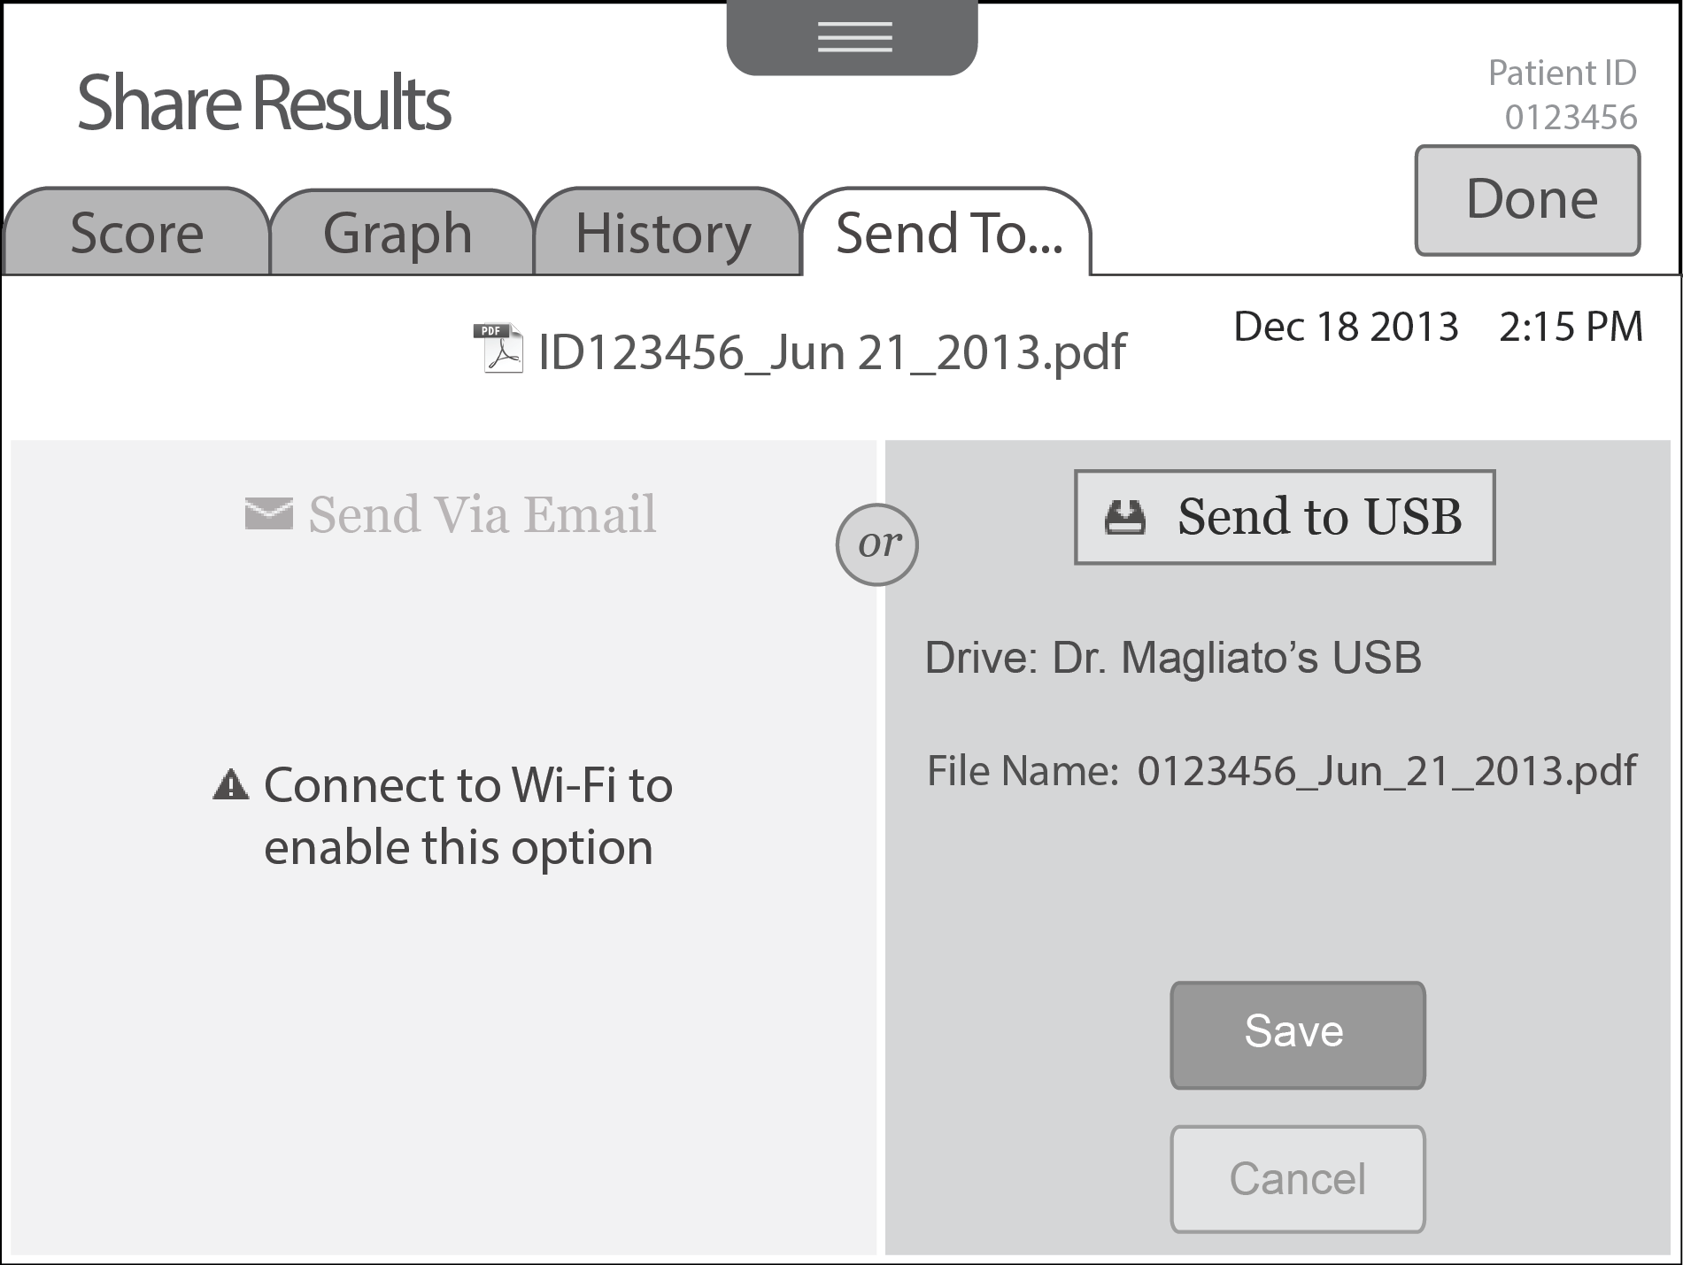
Wireframes Full Flow
Send to USB - Step 2
Notes:
Once the USB drive is inserted, the name of the drive will appear as well as the name of the file that will be saved. Users will press the Save button to save the file to USB.
Notes:
File name should be 01234

Slide 18
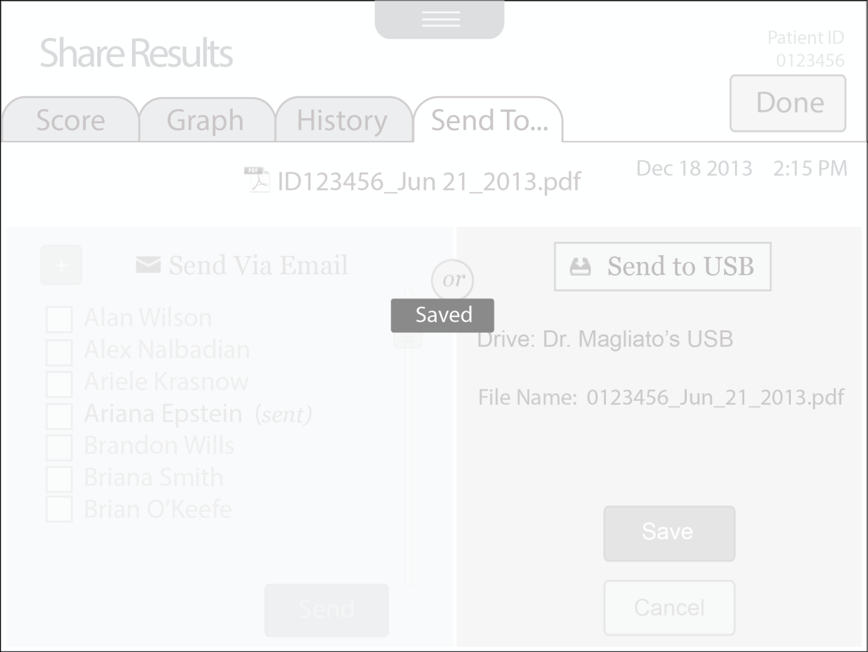
Wireframes Full Flow
Saved Confirmation Fades In and Fades Out

Slide 19
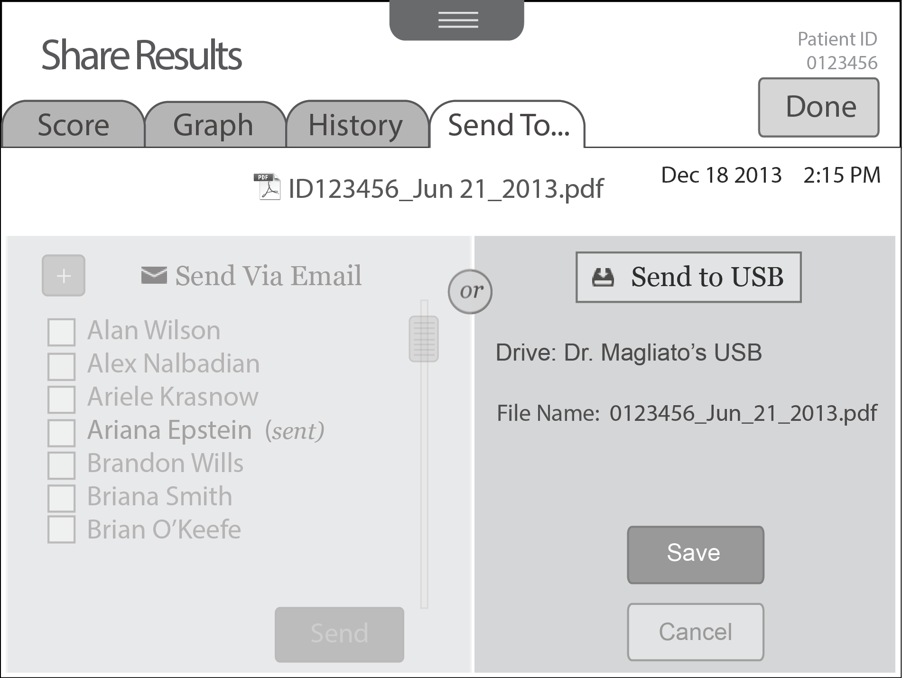
Wireframes Full Flow
Send to USB – When Send Via Email is disabled because the user chose Send to USB
Notes:
This scenario shows what the left side of the screen will look like when wifi is available . The left side will look disabled when the user chose the Send to USB option.

Slide 20
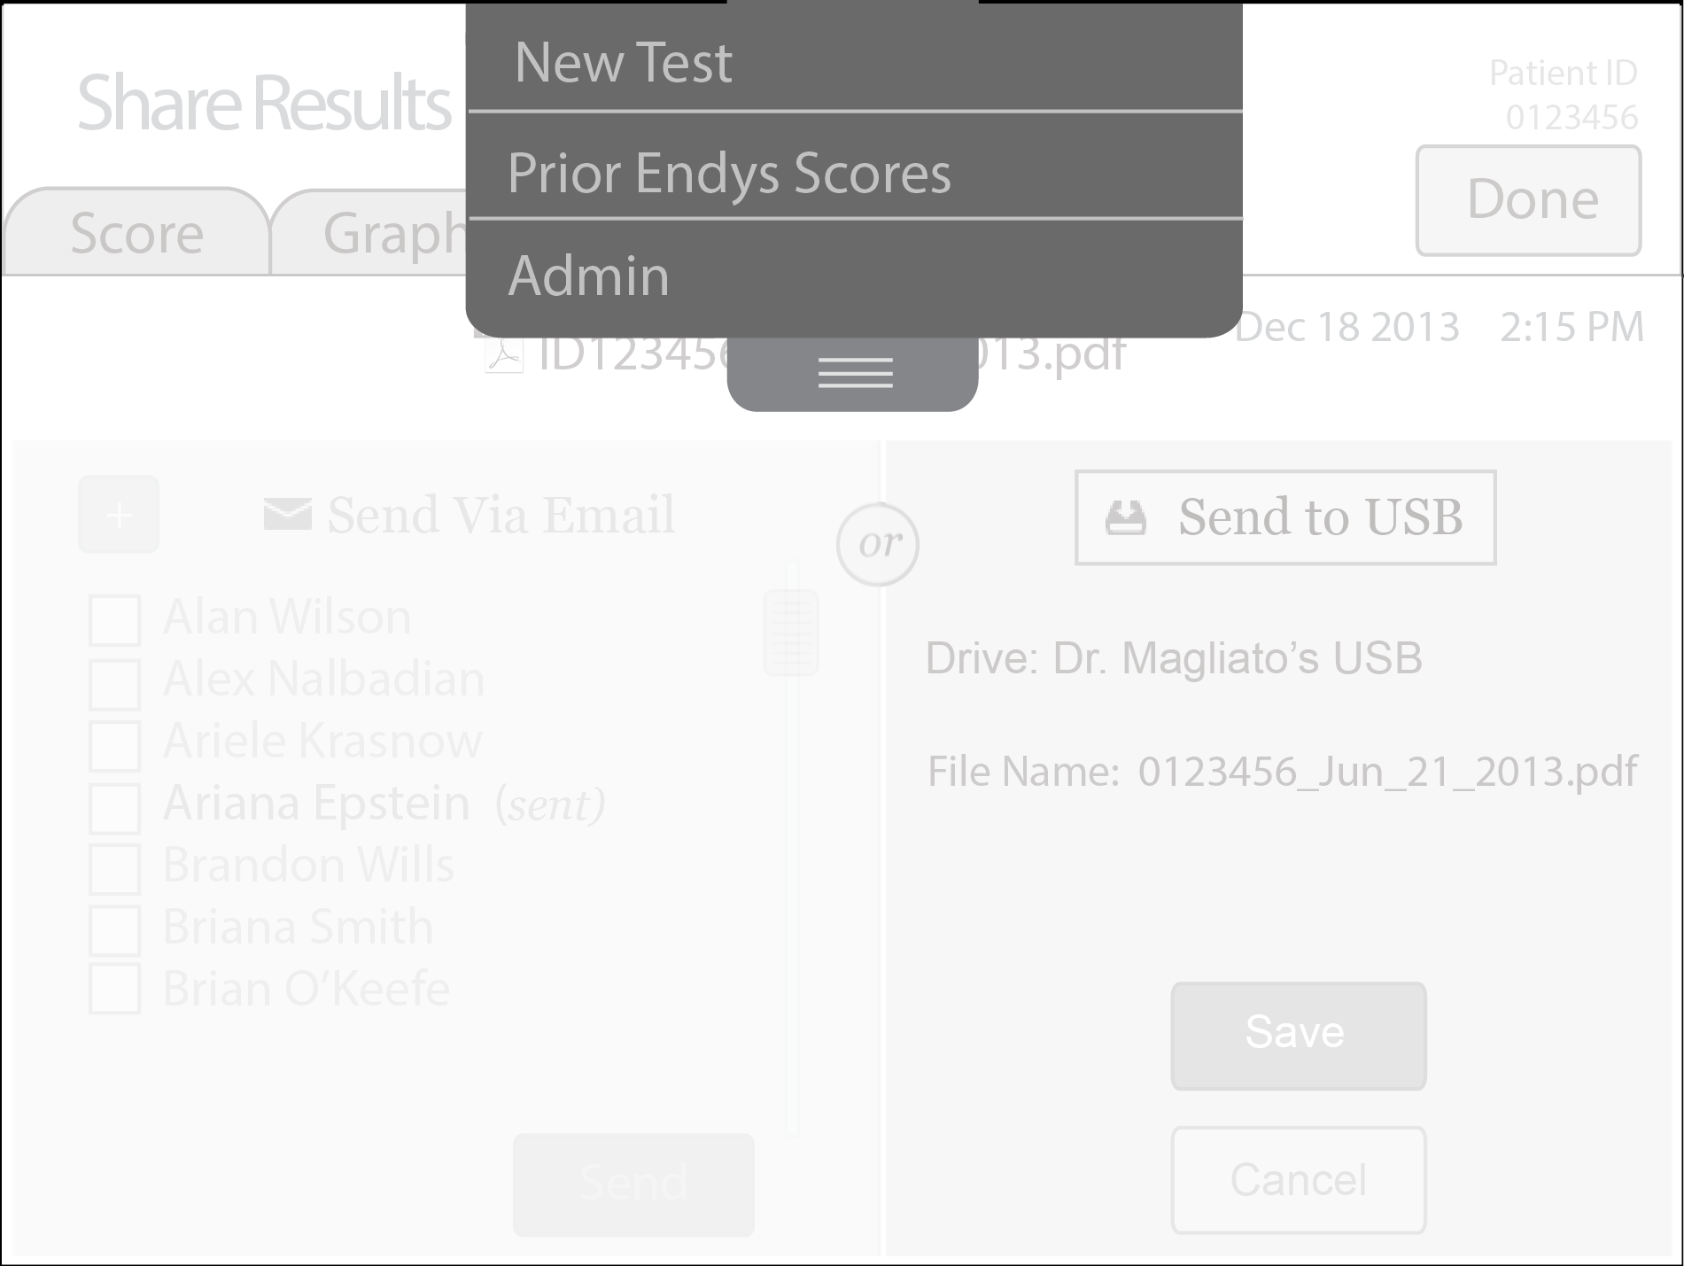
Wireframes Full Flow
Pull Down Menu
Notes:
If the user selects Prior EnDys Scores from the menu, they will be brought to the Prior EnDys Scores list on the next page.

Slide 21
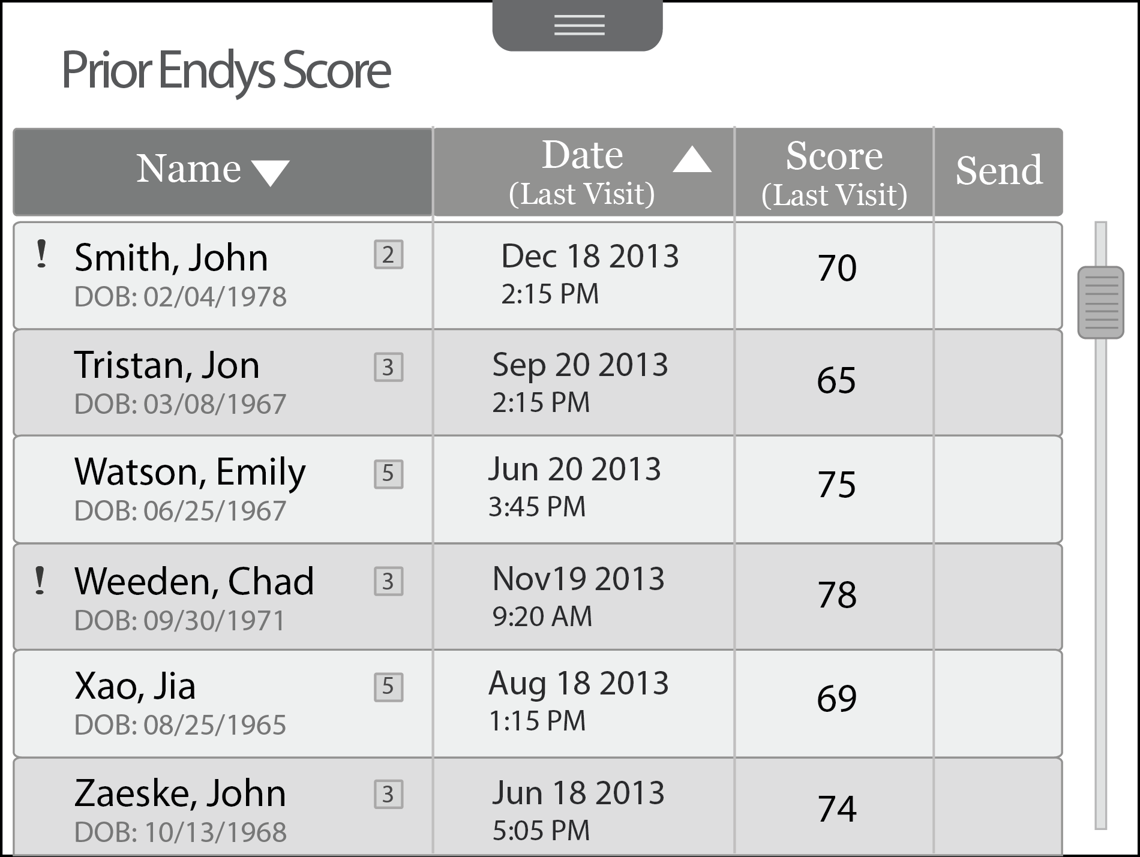
Wireframes Full Flow
Prior EnDys Scores, Sorted by Last Name
Notes:
The scores are sorted by last name. Alternatively, users can sort the list by date of last visit.
The exclamation mark means the last test has not been sent.

Slide 22
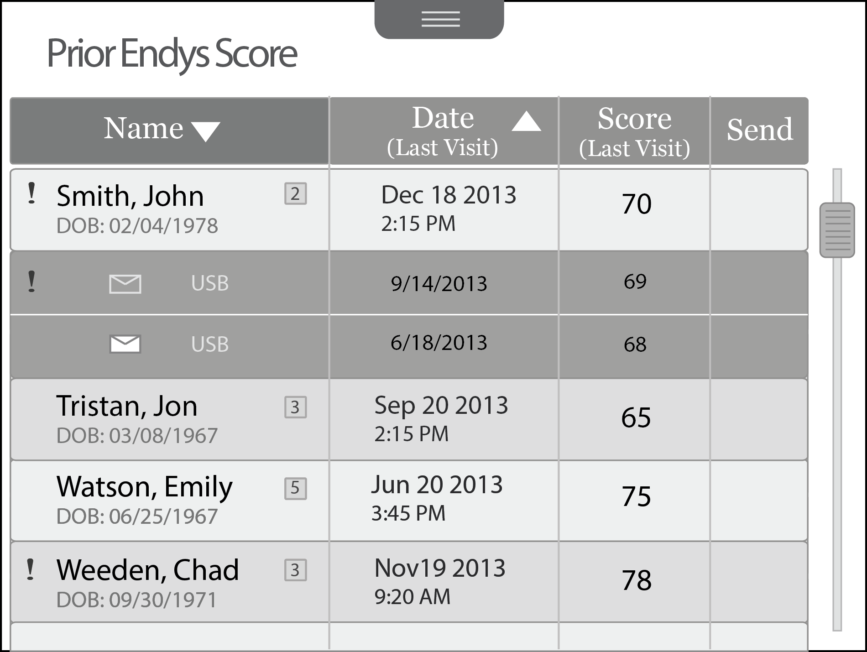
Wireframes Full Flow
John Smith Expanded
Notes:
Users can expand John Smith to see the list of scores for that patient.
The exclamation mark and the empty email icon signify that this score has not been sent.
If users click on a score, they will be brought to the history tab which will show the detail for that score (see next slide)

Slide 23
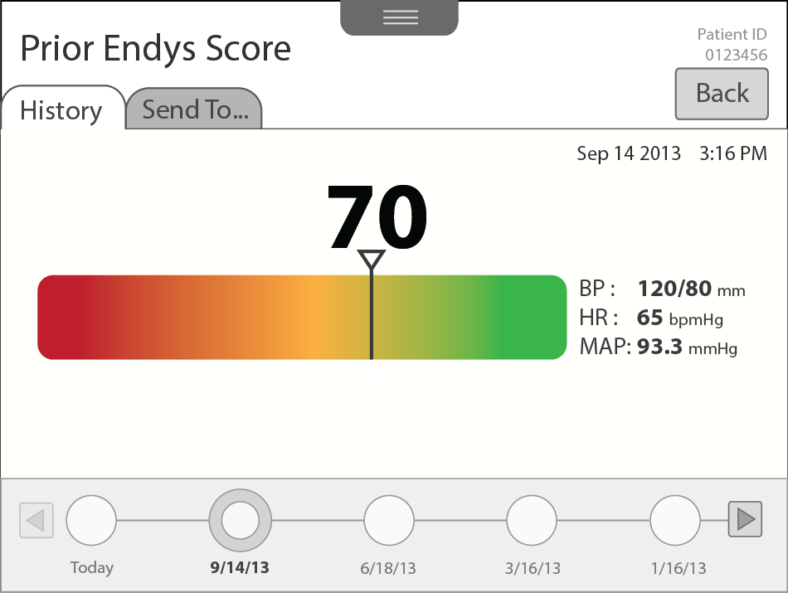
Wireframes Full Flow
Drilldown to EnDys Score History
Notes:
When the user drills down to the history, the page title says Prior EnDys Score

Slide 24
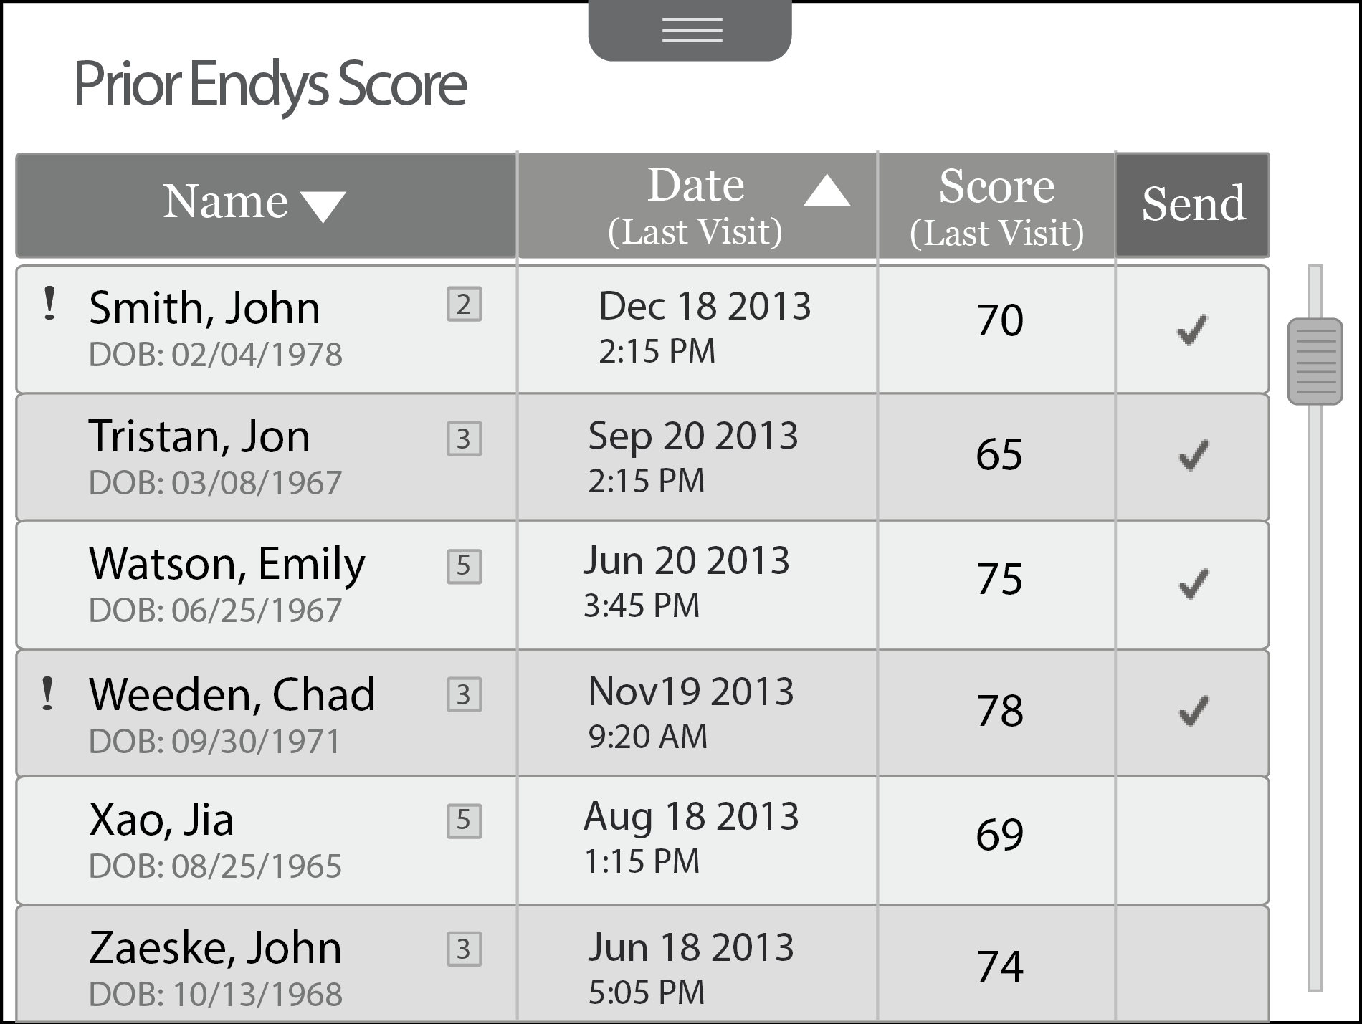
Wireframes Full Flow
Batch Send Capability
Notes:
Checking the cell in the Send column will send the most recent score for that patient.
Users can check multiple scores and batch them up for sending by pressing the Send button in the column heading.

Slide 25
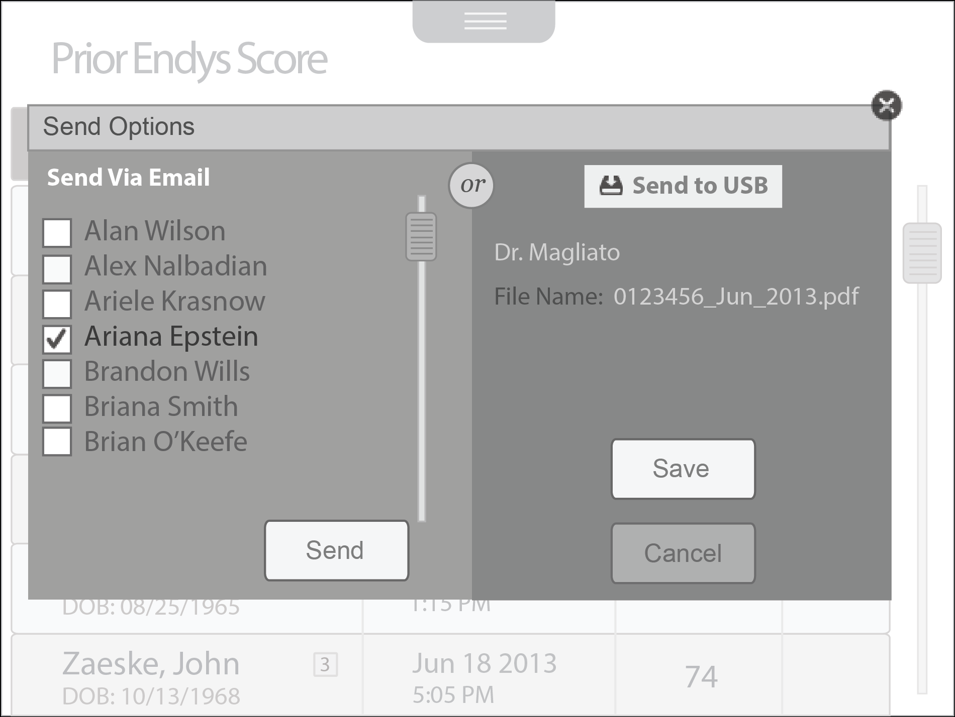
Wireframes Full Flow
Send Options Popup When Completing a Batch Send

Slide 26
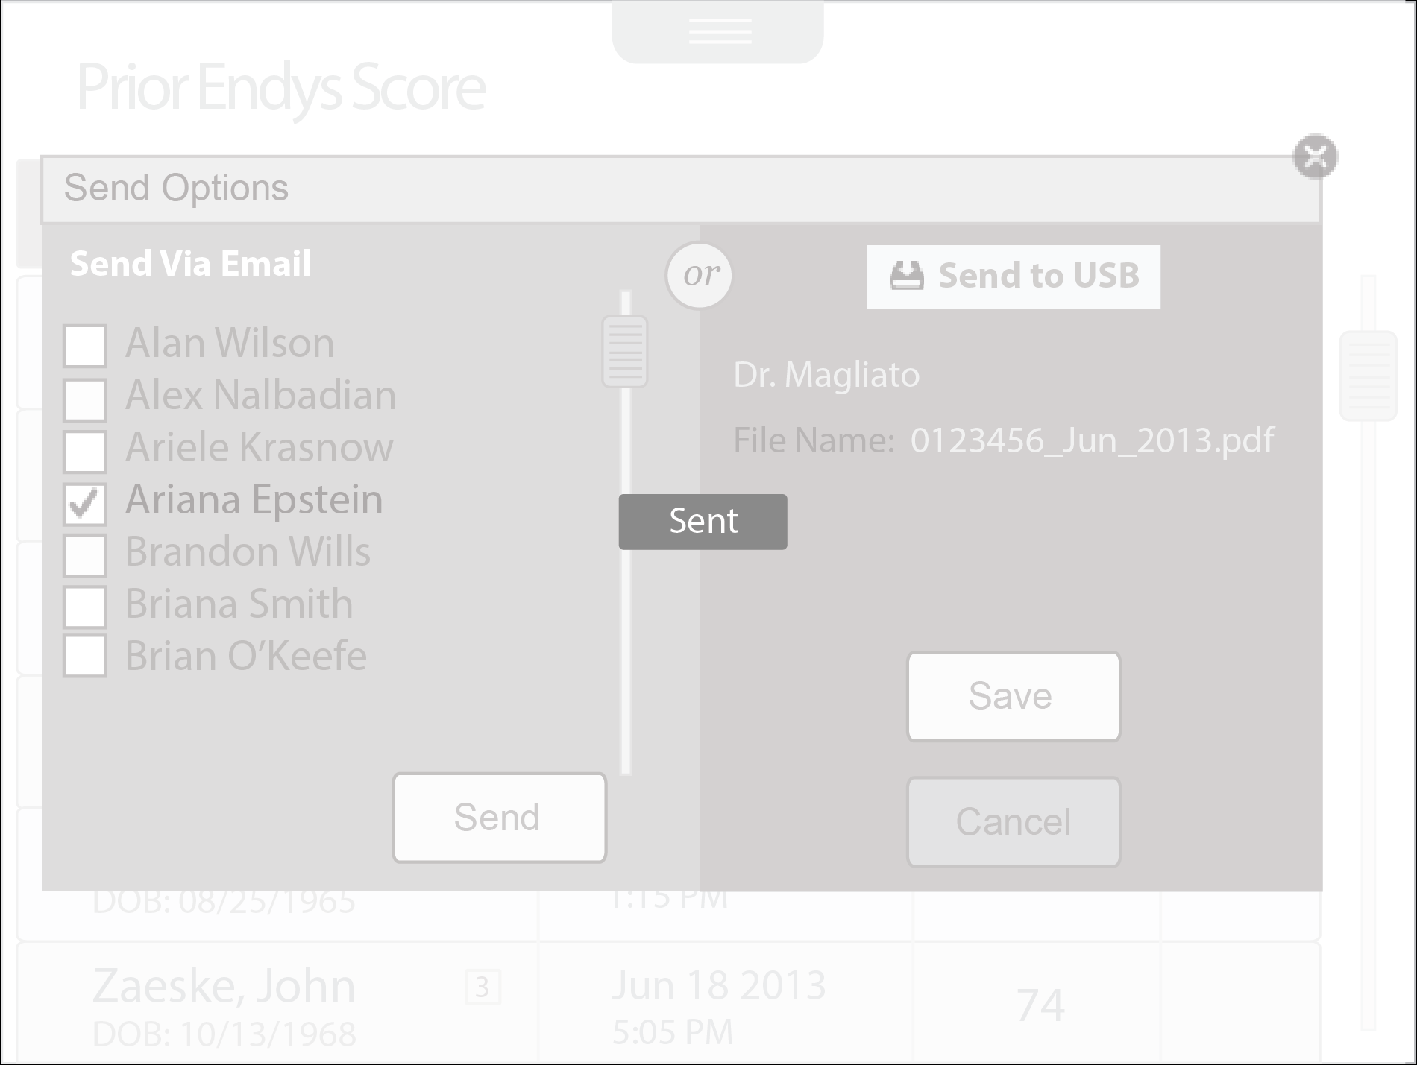
Wireframes Full Flow
Sent Confirmation

Slide 27


Business Center
12 Silver Lake Road
P.O. Box 1260
Hollis, NH 03049
Phone: 603 465-9800
Fax: 603 465-9801
Development Center
27 Proctor Hill Road
P.O. Box 1260
Hollis, NH 03049
Phone: 603 465-9800
Fax: 603 465-3287
www.farmdesigninc.com

